Slide 1

An EMBER Static Malware Analysis Tactical Decision Aid for Incident Responders
Joel Meoak, MSCS Student Beacom College of Computer and Cyber Sciences Dakota State University

Slide 2
Abstract
Many malware tools available, but they all have weaknesses
Elastic Malware Benchmark for Empowering Research (EMBER) trained malware models
Machine learning driven tactical decision aid
Evaluation against modern malware

Slide 3
Introduction
Incident Response Team Role
Identification, Analysis, Containment, Eradication, Recovery
Malware Identification Tools
Signature Repository
Sandboxes
EMBER Dataset
PE Headers, 800k samples
EMBER Malware Tactical Decision Aid (EMT) Framework

Slide 4
Objectives
Primary Goals: PE binary, Evaluation within 60 sec, offline usage, portable across linux or windows with python, DLL vs EXE detection
Secondary Goals: Evaluated performance of machine learning (ML) models trained on EMBER against modern malware and penetration testing tools using EMT

Slide 5
Background & Literature Review
EMBER Dataset
Academic Research
Existing Solutions

Slide 6
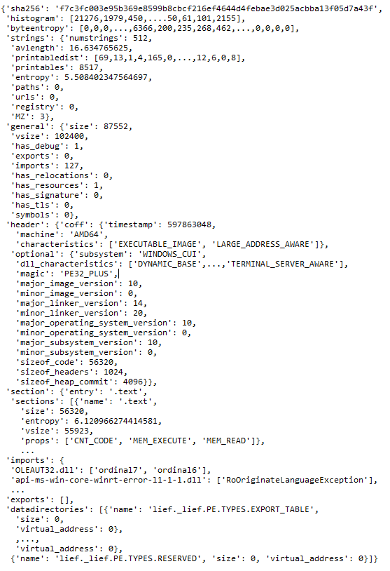
EMBER Dataset
Originally released in 2017 and updated in 2018
800k Training, 200k Testing Samples
50% Malware / 50% Benign
PE Header (EXE/DLL format)
Parsed with LIEF module
Byte Histogram, Byte Entropy Histogram, String Extractor, General File Info, Header File Info, Section Info, Imports Info, and Exports Info

Slide 7
Academic Research
Malware Detection through Machine Learning Techniques [10]
Accuracy above 99% and detection of 1 new samples
Evaluating Performance Maintenance & Deterioration Over Time of Machine Learning-Based Malware Detection Models on the EMBER PE Dataset [11]
Implementation of Random Forest and Detection of 2020 malware variants
Identifying Useful Features for Malware Detection in the EMBER Dataset [9]
83.7% Accuracy with 176 features instead of 2381 default
Top Feature Groups: General Info, Header Info, Strings

Slide 8
Existing Solutions
Online Sandboxes
Examples: Joe’s Sandbox and Any.Run
Disclosure of Proprietary Data [12]
Alert Attackers
Offline Sandboxes
Difficult Setup
Extensive Hardware
Signature Repositories
Weak Against New Malware
Alert Attackers

Slide 9
Methodology and Implementation
Machine Learning (ML) Engine
EMT Framework
Modern Malware and Penetration Tool Testing

Slide 10
Machine Learning Engine - Models
Scikit-Learn (Sklearn) Models:
Random Forest Classifier
Decision Tree Classifier
Extremely Random Forest Classifier
Logistic Regression
Gradient Boosting Classifier
Ada Boost Classifier
TensorFlow Keras’ Models:
Sequential Neural Network
Simple Recurrent Neural Network
Convolutional Neural Network

Slide 11
Table 1: Model Performance Against EMBER Test Dataset
Model | Model Notes | Data Subset | Accuracy (%) | Precision (%) | Recall (%) | F1 Score (%) | FPR (%) | FNR (%)
LightGBM | EMBER Provided | Total | 97.6 | 99.1 | 96.1 | 97.6 | 0.8 | 3.9
LightGBM | EMBER Provided | DLL Only | 96.5 | 99.0 | 88.9 | 93.7 | 0.4 | 11.1
Decision Tree |  | Total | 91.9 | 92.0 | 91.7 | 91.9 | 7.9 | 8.3
Decision Tree |  | DLL Only | 91.9 | 87.5 | 84.6 | 86.0 | 5.0 | 15.4
Random Forest |  | Total | 95.4 | 95.9 | 94.9 | 95.4 | 4.1 | 5.1
Random Forest |  | DLL Only | 94.4 | 94.6 | 86.0 | 90.1 | 2.1 | 14.0
Random Forest | DLL Weight 5 to 1 | Total | 95.2 | 95.7 | 94.7 | 95.2 | 3.5 | 5.6
Random Forest | DLL Weight 5 to 1 | DLL Only | 95.2 | 94.9 | 88.5 | 91.6 | 2.0 | 11.5
Extremely RF |  | Total | 95.4 | 96.4 | 94.4 | 95.4 | 3.5 | 5.6
Extremely RF |  | DLL Only | 94.2 | 95.3 | 84.4 | 89.5 | 1.7 | 15.6
Extremely RF | DLL Weight 5 to 1 | Total | 95.3 | 96.3 | 94.2 | 95.2 | 3.6 | 5.8
Extremely RF | DLL Weight 5 to 1 | DLL Only | 94.8 | 95.4 | 86.5 | 90.7 | 1.7 | 13.5
Logistic Regression |  | Total | 62.2 | 59.0 | 79.9 | 67.9 | 55.6 | 20.1
Logistic Regression |  | DLL Only | 51.2 | 32.9 | 63.2 | 43.3 | 53.8 | 36.8
Gradient Boosting |  | Total | 90.2 | 88.5 | 92.4 | 90.4 | 12.0 | 7.6
Gradient Boosting |  | DLL Only | 88.4 | 81.0 | 79.2 | 80.1 | 7.7 | 20.8
AdaBoost Classifier |  | Total | 95.1 | 95.8 | 94.3 | 95.1 | 4.1 | 5.7
AdaBoost Classifier |  | DLL Only | 94.7 | 94.6 | 86.8 | 90.5 | 2.0 | 13.2
Sequential | 8 Dense, 128 epoch | Total | 65.3 | 78.0 | 42.5 | 55.0 | 12.0 | 57.5
Sequential | 9 Dense, 32 epoch | Total | 60.6 | 57.5 | 81.4 | 67.4 | 60.2 | 18.6
Convolutional |  | Total | 64.2 | 61.9 | 73.6 | 67.3 | 45.3 | 26.4
Simple RNN |  | Total | 63.8 | 58.7 | 92.9 | 72.0 | 65.2 | 7.1

Slide 12
EMT Framework
Model Trainer (jupyter)
joblib
Model Evaluator
(jupyter)
joblib
EMT Framework (python or exe)
csv
VirusTotal Integrator (jupyter)
csv
Post Processing Module (jupyter)

Slide 13
Modern Malware & Penetration Tool Testing
Testing conducted on Linux virtual machine to protect against accidental execution
124 Modern Malware Samples [13]
2022 – 2023 Variants
Attributed to UNC2589 which targets Ukraine
89 EXEs, 36 DLLs
42 PenTesting Payloads
Metasploit Meterpreter [14]
12 Stageless
30 Stagers (Callback Beacons or Port Binder)

Slide 14
Results & Discussion
Modern Malware Performance
Penetration Testing Tool Performance

Slide 15
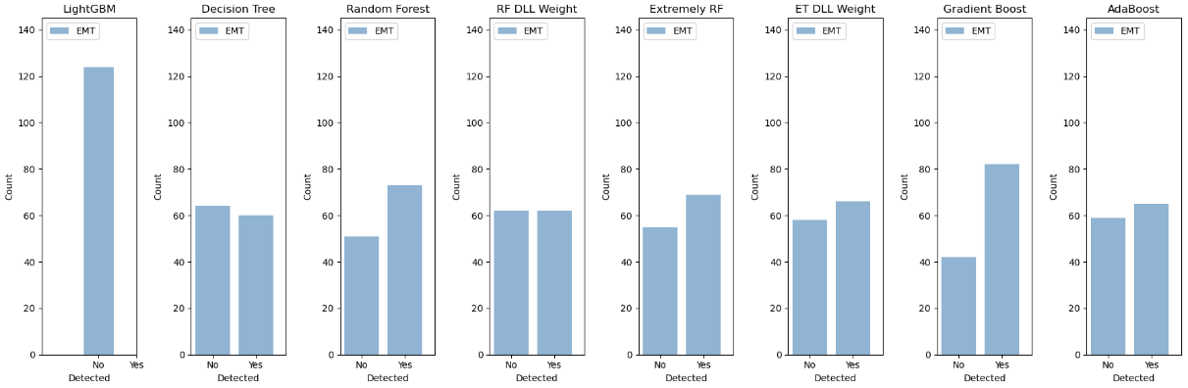
EMT Malware Detection

Slide 16
EMT Malware Detection
Top Acc: Gradient Boosting Classifier
Top Adj Acc: Random Forest
Adj Acc = (Acc * 124 + (1 - FPR) * 124) / 248
Table 2: Modern Malware EMT Testing Metrics
Model | Testing FPR (%) | Accuracy (%) | Adj Acc (%) | Detect Count
LightGBM | 0.8 | 0.0 | 49.6 | 0/124
Decision Tree | 8.0 | 48.4 | 70.2 | 60/124
Random Forest | 4.1 | 58.9 | 77.4 | 73/124
RF DLL Weight | 3.5 | 50.0 | 73.2 | 62/124
Extremely RF | 3.5 | 55.6 | 76.1 | 69/124
ET DLL Weight | 3.6 | 53.2 | 74.8 | 66/124
Gradient Boost | 12.0 | 66.1 | 77.0 | 82/124
AdaBoost | 4.1 | 52.4 | 74.2 | 65/124

Slide 17
EMT Malware Detection
Top Acc: Gradient Boosting Classifier
Top Adj Acc: Random Forest
Adj Acc = (Acc * 124 + (1 - FPR) * 124) / 248
Table 3: Modern Malware DLL EMT Testing Metrics
Model | Testing FPR (%) | Accuracy (%) | Adj Acc (%) | Detect Count
LightGBM | 0.4 | 0.0 | 49.8 | 0/36
Decision Tree | 5.0 | 44.4 | 69.7 | 16/36
Random Forest | 2.1 | 69.4 | 83.7 | 25/36
RF DLL Weight | 2.0 | 63.9 | 81.0 | 23/36
Extremely RF | 1.7 | 63.9 | 81.1 | 23/36
ET DLL Weight | 1.7 | 66.7 | 82.5 | 24/36
Gradient Boost | 7.7 | 91.7 | 92.0 | 33/36
AdaBoost | 2.1 | 69.4 | 83.7 | 25/36

Slide 18
EMT Malware Detection
Top Acc: Gradient Boosting Classifier
Top Adj Acc: Gradient Boosting Classifier
Best Model with Low FPR: Random Forest with DLL weighting
Adj Acc = (Acc * 124 + (1 - FPR) * 124) / 248
Table 4: Penetration Testing Tool Evaluation Metrics
Model | Testing FPR (%) | Accuracy (%) | Adj Acc (%) | Detect Count
LightGBM | 0.8 | 0.0 | 49.6 | 0/42
Decision Tree | 8.0 | 45.2 | 68.6 | 19/42
Random Forest | 4.1 | 47.6 | 71.8 | 20/42
RF DLL Weight | 3.5 | 59.5 | 78.0 | 25/42
Extremely RF | 3.5 | 45.2 | 70.9 | 19/42
ET DLL Weight | 3.6 | 52.4 | 74.4 | 22/42
Gradient Boost | 12.0 | 78.6 | 83.3 | 33/42
AdaBoost | 4.1 | 50.0 | 73.0 | 21/42

Slide 19
Conclusion
13 models trained, top 8 implemented in EMT Framework
Accounting for Adj Accuracy, Random Forest was identified as the top model
EMBER 2018 dataset is still relevant, but models trained on it can easily be overfit
Future Work
Additional modern malware testing (>400 samples)
Extensive neural network training

Slide 20
References
P. Cichonski, T. Millar, T. Grance, and K. Scarfone, Computer security incident handling guide (National Institute of Standards and Technology), NIST Series SP 800-61, Rev 2, Aug. 2012. doi:10.6028/nist.sp.800-61r2
M. Nieles, K. Dempsey, and V. Y. Pillitteri, An introduction to information security, (National Institute of Standards and Technology), NIST Series SP 800-12 Rev 1, Jun. 2017. doi:10.6028/nist.sp.800-12r1
“How it works,” VirusTotal, https://docs.virustotal.com/docs/how-it-works (accessed Feb. 19, 2024).
“What is cuckoo?” Cuckoo Sandbox, https://cuckoo.readthedocs.io/en/ latest/introduction/what/ (accessed Feb. 19, 2024).
H. Anderson and P. Roth, “EMBER: an open dataset for training static pe malware machine learning models,” arXiv:1804.04637 [cs.CR], April 2018, Available: https://arxiv.org/pdf/1804.04637.pdf
Microsoft, “PE format - win32 apps,” Microsoft Learn, https://learn.microsoft.com/en-us/windows/win32/debug/pe-format (accessed Feb. 19, 2024).
J. Leyden, “64-bit malware threat may be itty-bitty now, but it’s only set to grow,” The Register, https://www.theregister.com/2017/05/24 /64bit_malware/ (accessed Feb. 19, 2024).
P. Roth, “EMBER Improvements,” Presented at CAMLIS 2019. Available: https://www.camlis.org/2019/talks/roth
Y. Oyama, T. Miyashita, and H. Kokubo, “Identifying useful features for malware detection in the ember dataset,” 2019 Seventh International Symposium on Computing and Networking Workshops (CANDARW), Nov. 2019. doi:10.1109/candarw.2019.00069
A. Amer and N. A. Aziz, “Malware detection through Machine Learning Techniques,” International Journal of Advanced Trends in Computer Science and Engineering, vol. 8, no. 5, pp. 2408–2413, Oct. 2019. doi:10.30534/ijatcse/2019/82852019
C. Galen and R. Steele, “Evaluating performance maintenance and deterioration over time of machine learning-based malware detection models on the ember pe dataset,” 2020 Seventh International Conference on Social Networks Analysis, Management and Security (SNAMS), Dec. 2020. doi:10.1109/snams52053.2020.9336538
P. Arntz, “Why you shouldn’t automate your virustotal uploads,” Malwarebytes, https://www.malwarebytes.com/blog/news/2022/04/why-you-shouldnt-automate-your-virustotal-uploads (accessed Feb. 19, 2024).
M. Parkour, “Malware arsenal used by Ember Bear (aka UAC-0056, Saint Bear, UNC2589, Lorec53, ta471, Nodaria, nascent Ursa, LorecBear, Bleeding Bear, and Dev-0586) in attacks targeting Ukraine.” contagio. (n.d.). https://contagiodump.blogspot.com/2023/02/malware-arsenal-used-by-ember-bear-aka.html
Metasploit Unleashed: About the Metasploit meterpreter. OffSec. (n.d.). https://www.offsec.com/metasploit-unleashed/about-meterpreter/ (accessed Apr. 10, 2024)
“Virustotal API V3 overview,” VirusTotal, https://docs.virustotal.com /reference/overview (accessed Apr. 20, 2024).

